Slide 1
MSC DSBA Strategy & Management
Thierry GODELLE
Session 7
1

Slide 2
Value Chain

Slide 3
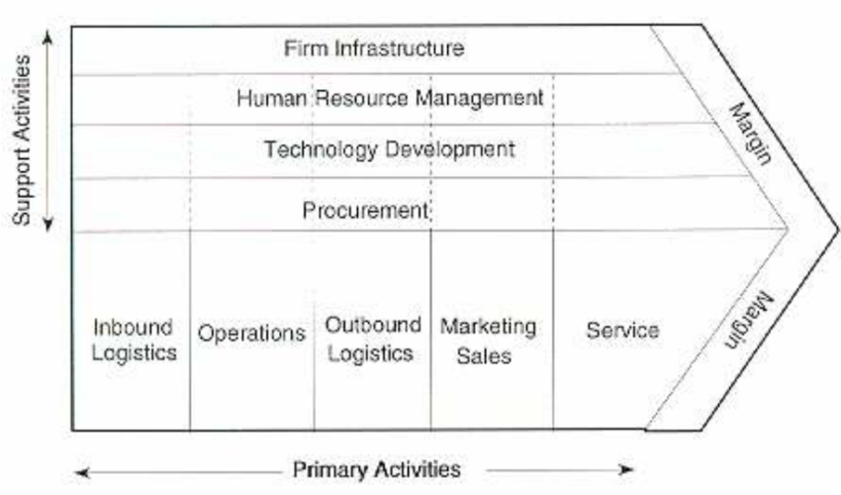
The company as a value chain
Main activities / support activities
Value (to the customer) / Costs (structure)
Internal links / External links
3

Slide 4
Designing the value chain
assess the contribution of each unit to the cost and value of the offer
allocate resources between activities
evaluate the links with upstream and downstream partners
identify where to start and stop the company's activities

Slide 5
Method: Choices in value chain design
Distinguish between the primary and support activity groups leading to the finished product or service available on its market
For each activity, identify the resources that make it up (equipment, personnel,) and that represent a significant part of the costs and value
Identify outsourcing and integration choices, processes that allow consistency between internal and external links, in particular IT tools

Slide 6
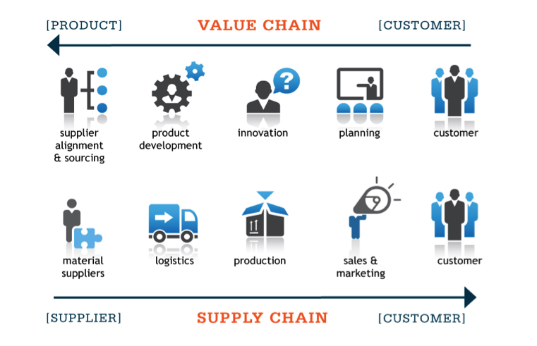
Supply Chain / Value Chain
The Supply chain corresponds to the flow of information, products, materials and finance between the different stages of the Value chain

Slide 7
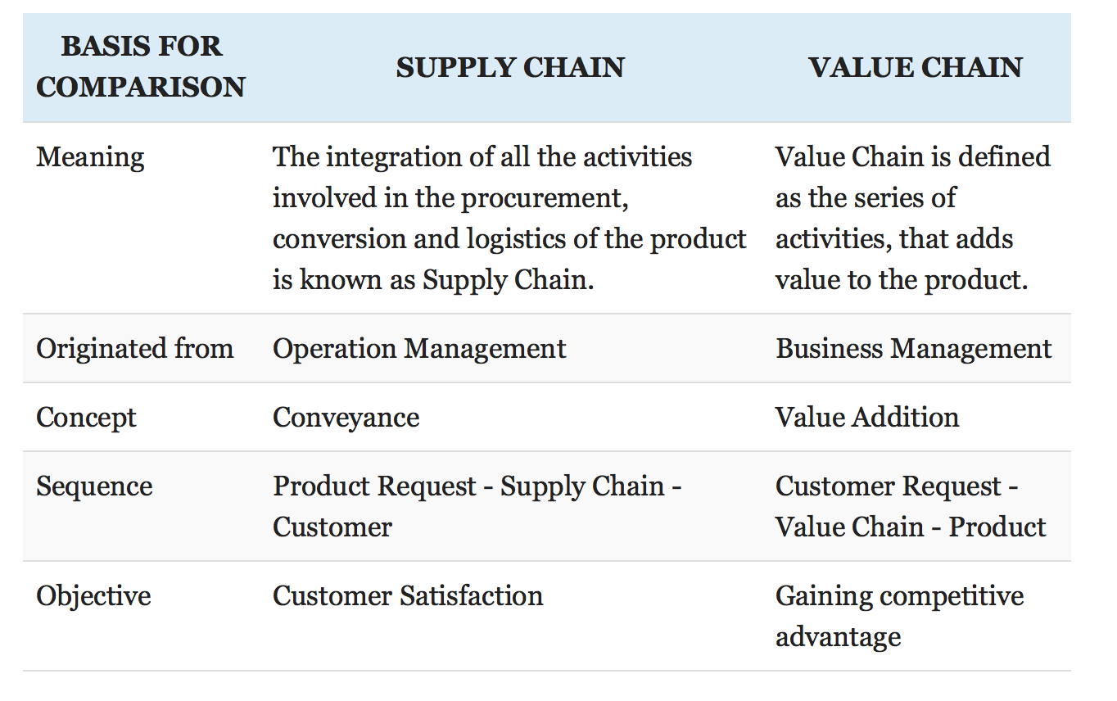
Supply Chain / Value Chain

Slide 8
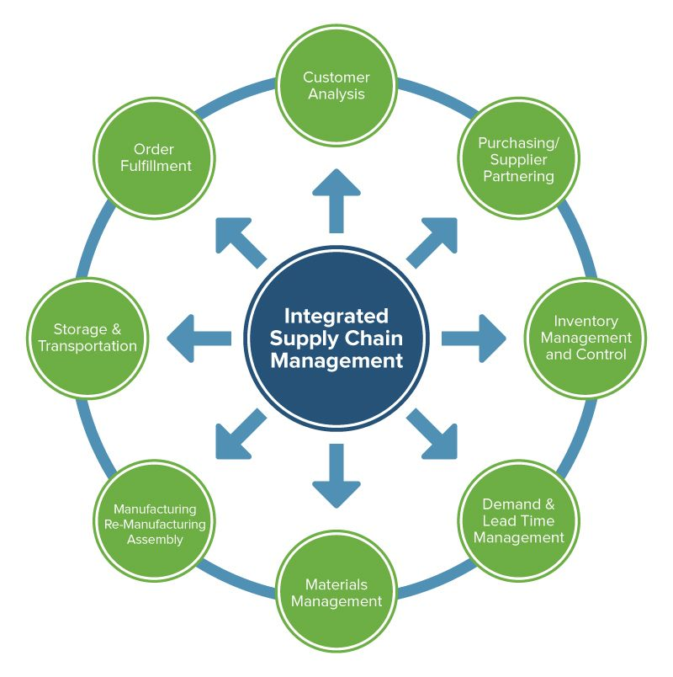
Supply chain management
Plan and design a product to meet consumer demand
Supply the materials or components for production
Planning of production and delivery
Deliver the product: Management of stocks and product flows to avoid supply disruptions.
Accept returns of defective products

Slide 9
Synchronize supply flows with value flows
Rapid evolution of customer demands in terms of tastes, preferences
Integrate supply chains and value chains :
the material flow and product delivery are synchronized and streamlined,
information, knowledge and financial flows are integrated and instantaneous.
This requires:
a good integration between product design, production capacity, delivery processes and customer demand information.
a global vision of the process from start to finish throughout the product life cycle and across geographical borders.
Companies that fully integrate simultaneous value and supply flows achieve high performance.

Slide 10
Industry as a value chain
Analyze an industry as a value chain:
identify the main players and their businesses
... but above all the resources they have at their disposal and the share of the value they capture.
This allows to:
identify where to start and stop the company's activities in the value chain
to identify alternative opportunities and models.

Slide 11
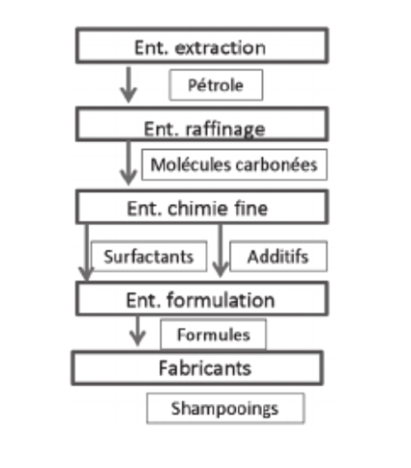
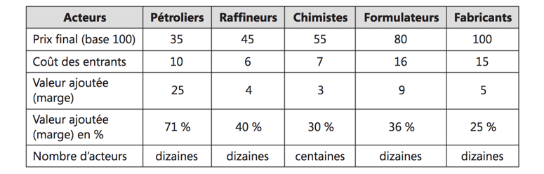
La filière Shampoing

Slide 12
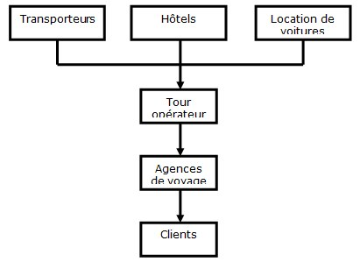
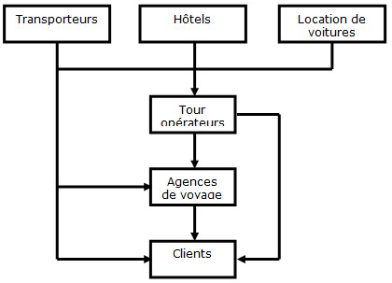
Value chain and value chain Tourism and disintermediation
Before internet
After internet
12

Slide 13
Case Study ZARA Value chain

